Slide 1
Integrating Quality in Teaching: Lessons from Software Quality How software quality principles can inspire and improve educational practices
Archana Raghu

Slide 2
What is Software Quality?
• Ensures apps, websites, and games work as expected
• Prevents frustrating user experiences and major failures
• Have you ever used an app that crashed or a game with glitches?

Slide 3
Software Testing
Software Development
Understanding Technical Know Hows
Developing Automated Tests
Understanding Business
Understanding the Promise
Some requirements have to be read between the lines
Communication
Bridging the gap between Software Development and Business

Slide 4
What is Software Quality?
Definition: Ensuring software meets expected functionality, performance, security, and usability.
Key Aspects of Software Quality:
Functionality – Does the software do what it should?
Usability – Is it easy to use?
Security – Can hackers exploit it?
Performance – Does it work fast and efficiently?

Slide 5
Fun Facts About Software Testing
• The first computer bug was an actual moth!
• Google, Amazon, and Microsoft hire thousands of QA engineers
• Video game testers are part of the QA world!

Slide 6
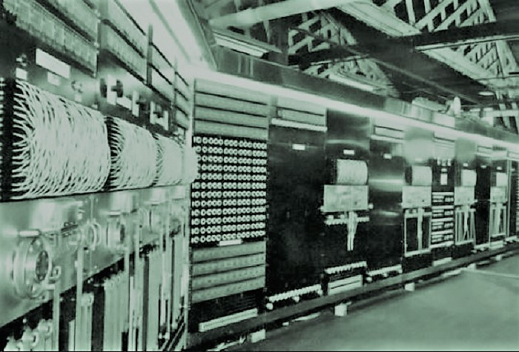
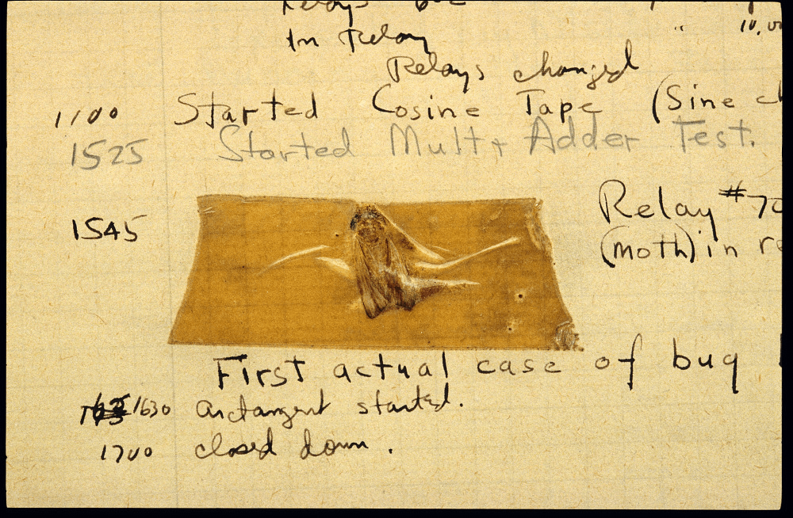
In 1947, a team working on the Harvard Mark II computer discovered a malfunction caused by an actual moth trapped in a relay.
Harvard Mark II
The team removed the moth and taped it into a logbook, labeling it as the “first actual case of a bug being found.”

Slide 7
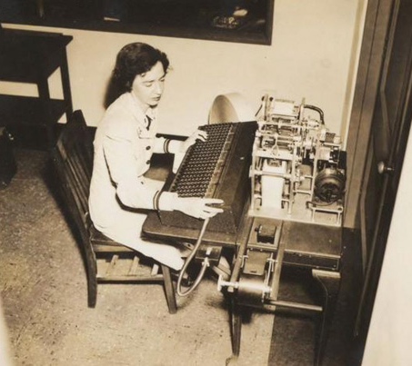

Grace “Amazing Grace” Hopper
While the term “debugging” had existed before, Grace Hopper helped popularize it in computing, making this incident a famous part of computer history.

Slide 8


NASA lost $327.6 Million
The Mars Climate Orbiter, part of the Mars Surveyor '98 program, was designed to study Mars' climate, atmosphere, and surface changes
A mismatch between the metric units used by NASA and the imperial units used by the spacecraft builder, Lockheed Martin
Mars Climate Orbiter (artistic illustration)
MCO Trajectory
This unit mismatch caused the spacecraft to enter Mars' atmosphere at a much lower altitude than intended, resulting in its destruction

Slide 9
The Ariane 5 Explosion (1996) – A software bug caused the European Space Agency’s rocket to self-destruct seconds after launch, costing $370 million.
The Y2K Bug (1999-2000) – A date storage issue that caused global panic and led to massive software fixes worldwide.
Therac-25 Radiation Machine (1985-1987) – A software bug in a medical radiation machine led to overdoses and patient deaths.
Knight Capital’s $440 Million Trading Bug (2012) – A financial software glitch caused a massive market loss in 45 minutes.

Slide 10
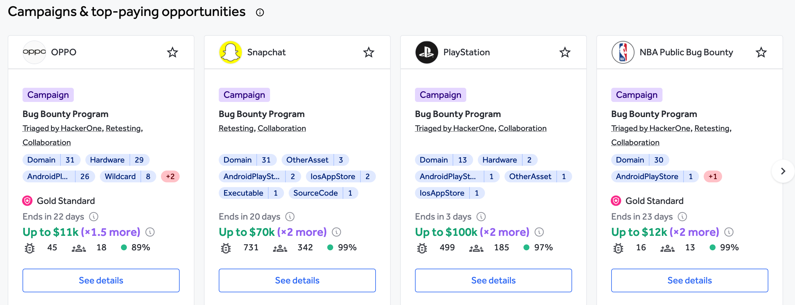
Many companies offer bug bounties, where they pay hackers (ethical ones!) to find security bugs.
Source: hackerone.com
Google, Facebook, and Apple have paid out millions in bug bounty programs

Slide 11
What Do QA Engineers & Testers Do?
• Find and report software bugs before users do
• Work with developers to improve software reliability
• Use automation, performance, and exploratory testing
• Think of it as being a "detective" for software problems!

Slide 12
Unique Career Paths
Software Tester: Finds bugs in apps before release.
Automation Engineer: Writes code that tests software automatically.
Security Tester (Ethical Hacker): Protects systems from cyber threats.
DevOps Engineer: Ensures smooth deployment of software updates.
Game Tester: Tests and improves video games.
AI Quality Engineer: Ensures AI models are fair and accurate.
Performance Engineer: Makes software faster and more efficient.

Slide 13
How Teachers Can Inspire Students
• Simple Classroom Activities:
1. “Find the Bug” – Have students test a simple app and document issues.
2. “Debugging Challenge” – Give students a code snippet with errors to fix.
3. “Career Day” – Invite software testers to share their experiences.
• Encouraging Critical Thinking:
• Have students analyze why some apps are more user-friendly than others.
• Useful Resources for Teaching:
• Free online tools: Selenium (automation), Bugzilla (bug tracking).
• Websites: Coursera, Udemy, Khan Academy (basic testing courses).

Slide 14
What is Software Testing
• The process of finding and fixing bugs before release.
• Types of Testing:
• Manual Testing – Humans test apps like a user.
• Automated Testing – Programs test apps automatically.
• Performance Testing – Measures speed & stability.
• Security Testing – Checks for vulnerabilities.
• Quick Demo: Use a basic buggy website and show how a test script works.

Slide 15
Why is Software Quality a Great Career?
• High demand in tech industries (games, healthcare, finance, etc.)
• Opportunities in automation, AI testing, security testing
• Great for problem-solvers and detail-oriented thinkers
• Can lead to roles in development, DevOps, or cybersecurity

Slide 16
Strategies to Integrate Quality Concepts into Curriculum
Enhances critical thinking, problem-solving, and attention to detail
Encourages teamwork and clear communication
Highlights the importance of reliable technology

Slide 17
Classroom Strategies for Teaching Software Quality
Science Classes:
Discuss famous software errors (like NASA's Mars Orbiter incident) in lessons on precision and accuracy.
Use simulations or simple programs to demonstrate scientific concepts and incorporate debugging exercises.
Math Classes:
Introduce logic and algorithmic thinking through basic coding exercises.
Highlight the importance of accuracy through arithmetic puzzles involving intentional mistakes in code.
Language Arts:
Improve writing clarity by having students write clear, step-by-step bug reports.
Analyze instructions for clarity, highlighting how unclear instructions can lead to mistakes (bugs).
Social Studies:
Explore historical impacts of technology errors (Y2K, security breaches, etc.).
Discuss the ethical implications and responsibilities in technology usage.

Slide 18
Age-Appropriate Activities
Elementary School
Visual debugging puzzles with Scratch
Spot-the-error in visual or interactive stories
Middle School
Team debugging sessions in Python or JavaScript
Class discussions on technology failures in daily life
High School
Building and running automated tests
Exploring advanced topics: performance, security testing

Slide 19
Benefits of Teaching Software Quality
Equips students with essential skills for the digital age
Prepares students for STEM-related career paths
Develops appreciation and understanding of technology's impact

Slide 20
Quick Activities to Embed Software Quality
Bug Reporting:
Teach students the skill of documenting and reporting issues clearly.
Practice this with non-technical examples first (like describing issues in everyday processes).
Mini Quality Challenges:
Brief weekly coding challenges with intentional mistakes for students to debug collaboratively.

Slide 21
Tools and Resources for Teachers
Visual Learning: Scratch, Blockly
Interactive Platforms: Code.org, Khan Academy
Advanced Learning: Test Automation University, Bug Bounties, Open-source Projects

Slide 22
Benefits to Students
Enhances critical thinking and problem-solving skills.
Develops communication and collaborative teamwork.
Cultivates resilience and patience through debugging and iterative improvement.

Slide 23
Final Thoughts & Q&A
• Software quality affects everyone
• A career in QA can be exciting and rewarding
• Any questions?

Slide 24
Software Testing
Software Development
Understanding Technical Know Hows
Developing Automated Tests
Understanding Business
Understanding the Promise
Some requirements have to be read between the lines
Communication
Bridging the gap between Software Development and Business

Slide 25
Software Testing
Software Development
Promise you make
Software Testing
Promise you keep

Slide 26
Software Testing Process
Requirements → Evaluate → Reporting
# 1. Getting Requirements
# 2. Finding Bugs
# 3. Reporting Bugs

Slide 27
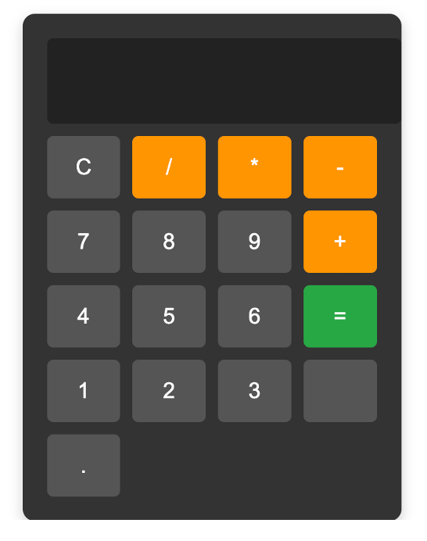
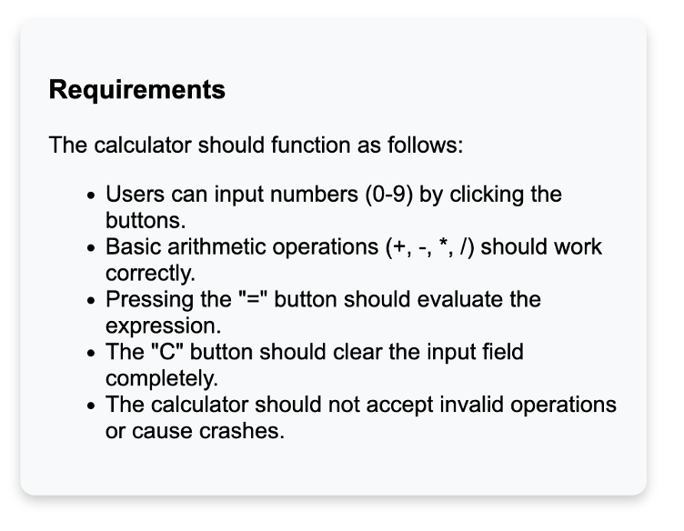
Buggy Calculator App

Slide 28
# 1. Getting Requirements
Buggy Calculator App
Promise
(Expected Functionality)

Slide 29
# 2. Evaluation
(Finding Bugs)
BUG: Misaligned CSS, spaces are not evenly distributed
BUG: Missing label for 0
BUG: Incorrect Operation

Slide 30
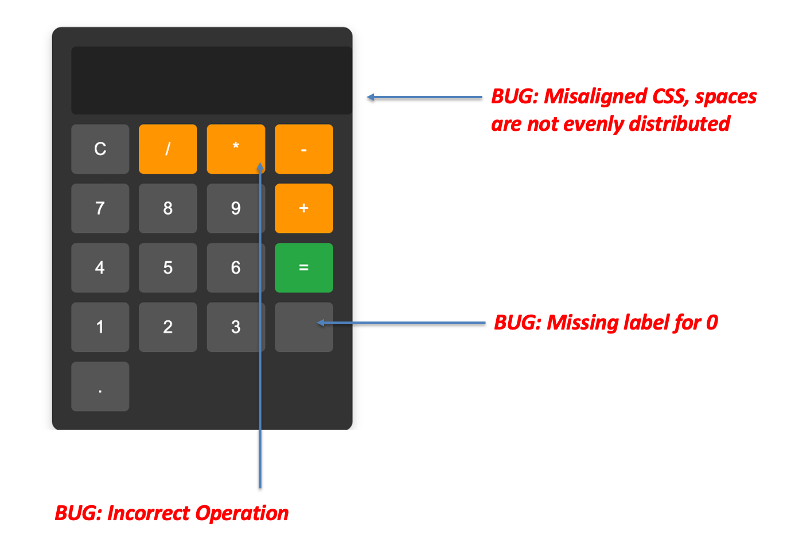
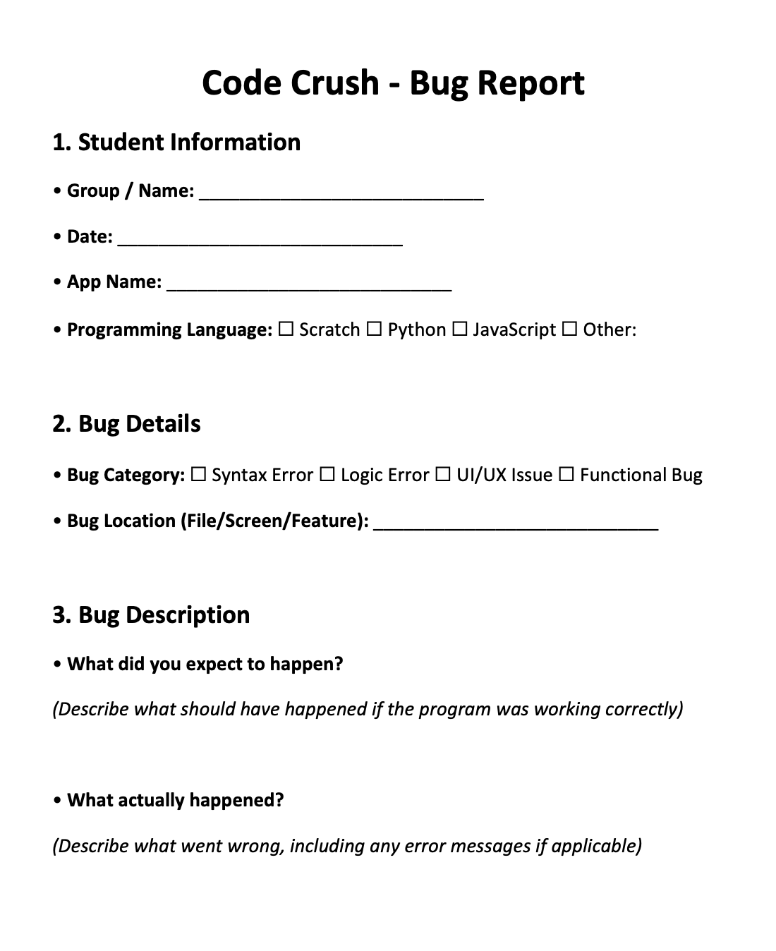
# 3. Reporting Bugs

Slide 31
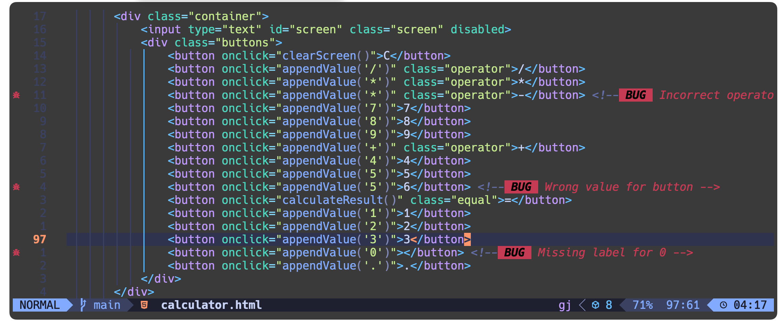
Buggy App
# 4. Fixing Bugs
Source Code

Slide 32
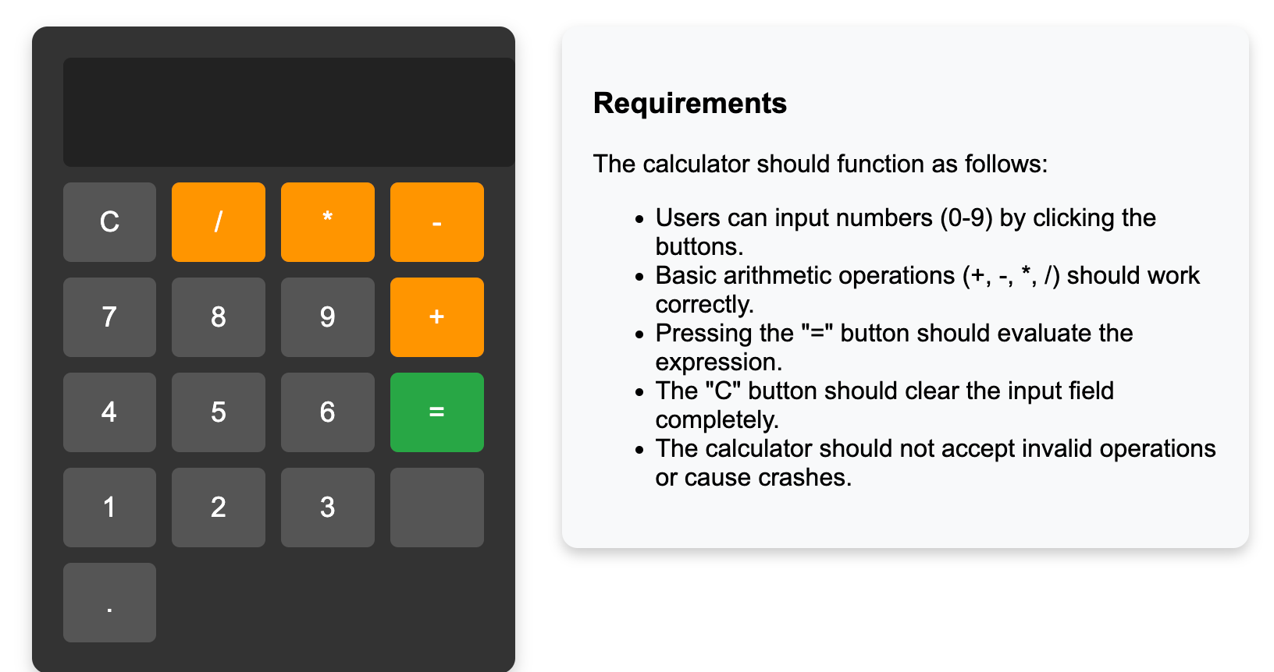

Slide 33
